Slide 1
Signal Processing First
Lecture 8
Fourier Series & Spectrum
© 2003, JH McClellan & RW Schafer

Slide 2
READING ASSIGNMENTS
This Lecture:
  Fourier Series in Ch 3, Sects 3-4, 3-5 & 3-6
    Replaces pp. 62-66 in Ch 3 in DSP First
    Notation: a_{k} for Fourier Series
Other Reading:
  Next Lecture: Sampling
© 2003, JH McClellan & RW Schafer

Slide 3
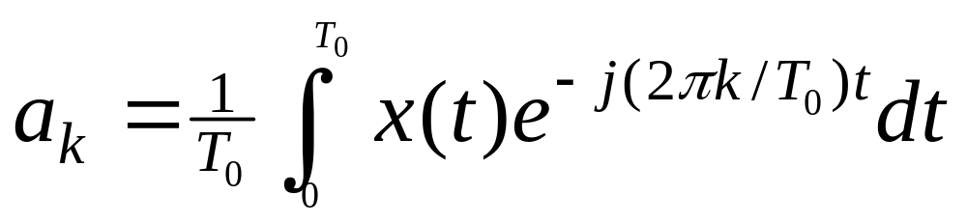
LECTURE OBJECTIVES
ANALYSIS via Fourier Series
  For PERIODIC signals: x(t+T₀) = x(t)
SPECTRUM from Fourier Series
  a_{k} is Complex Amplitude for k-th Harmonic
© 2003, JH McClellan & RW Schafer

Slide 4
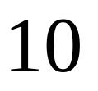
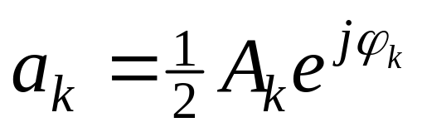
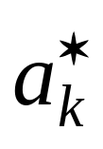
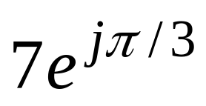
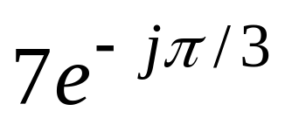
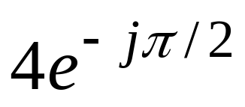
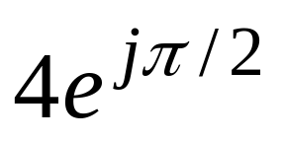
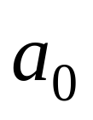
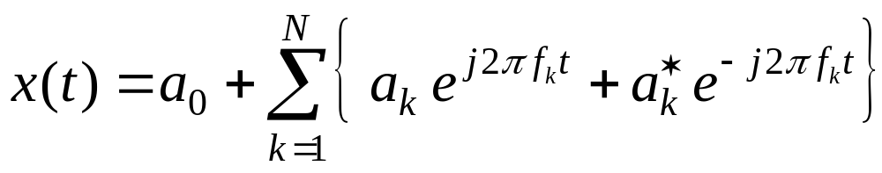
SPECTRUM DIAGRAM
Recall Complex Amplitude vs. Freq
–250
–100
0
100
250
f (in Hz)
© 2003, JH McClellan & RW Schafer

Slide 5
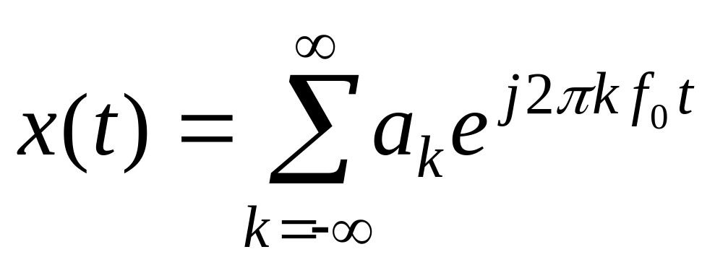
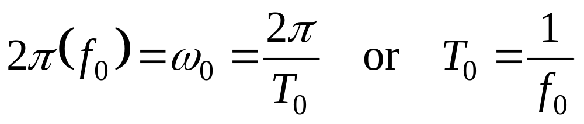
Harmonic Signal
PERIOD/FREQUENCY of COMPLEX EXPONENTIAL:
© 2003, JH McClellan & RW Schafer

Slide 6
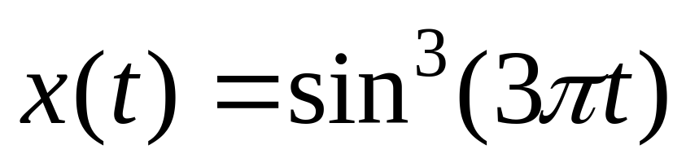
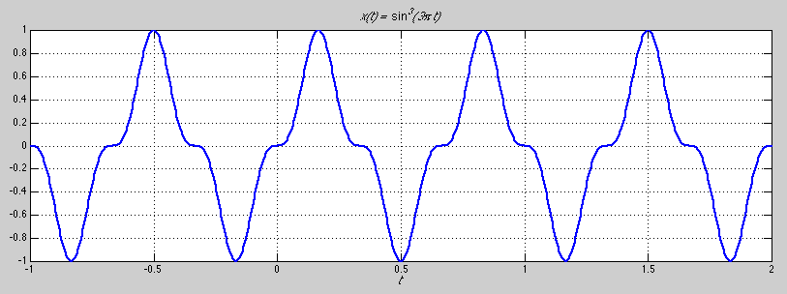
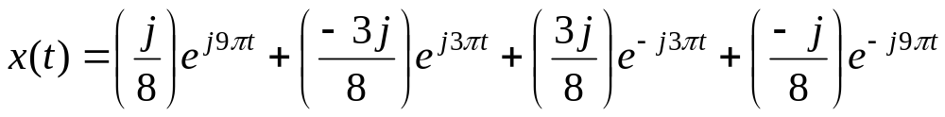
Example
© 2003, JH McClellan & RW Schafer

Slide 7
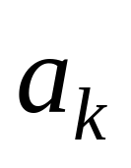
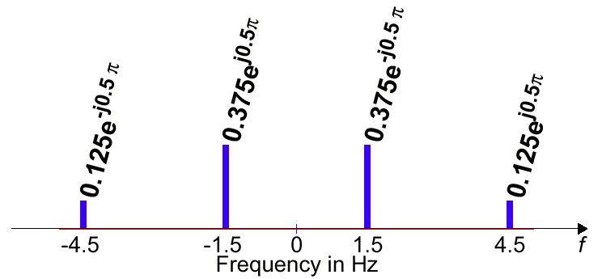




Example
In this case, analysis
just requires picking
off the coefficients.
© 2003, JH McClellan & RW Schafer

Slide 8
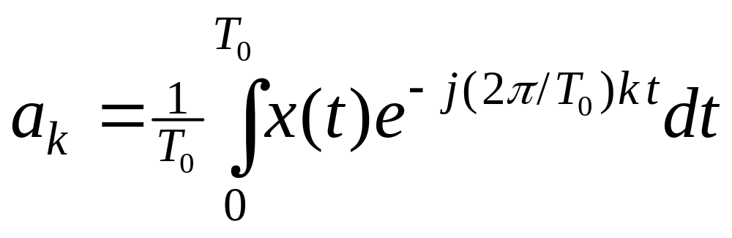
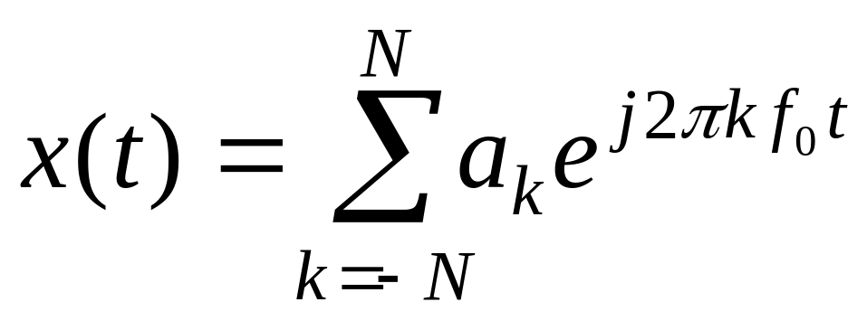
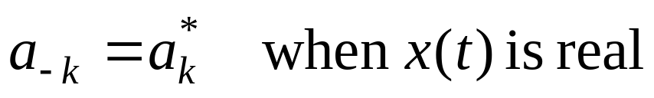
Fourier Series Synthesis
HOW do you APPROXIMATE x(t) ?
Use FINITE number of coefficients
© 2003, JH McClellan & RW Schafer

Slide 9
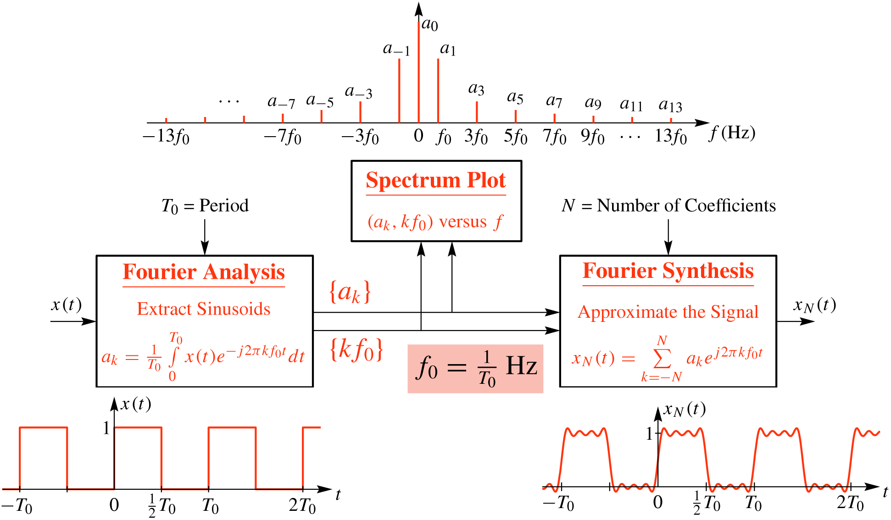
Fourier Series Synthesis
© 2003, JH McClellan & RW Schafer

Slide 10
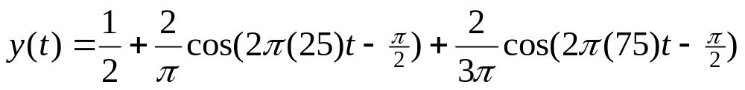
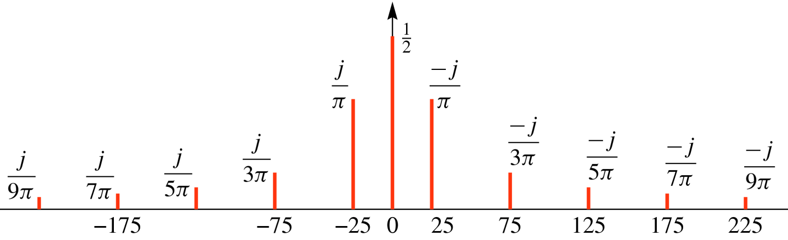
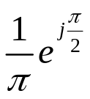
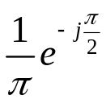
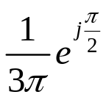
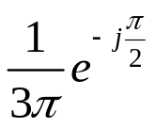
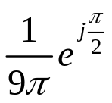
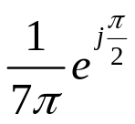


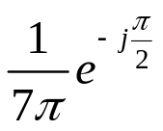

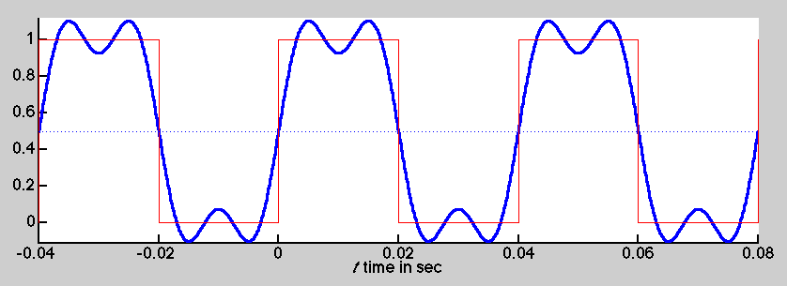
Synthesis: 1st & 3rd Harmonics
© 2003, JH McClellan & RW Schafer

Slide 11
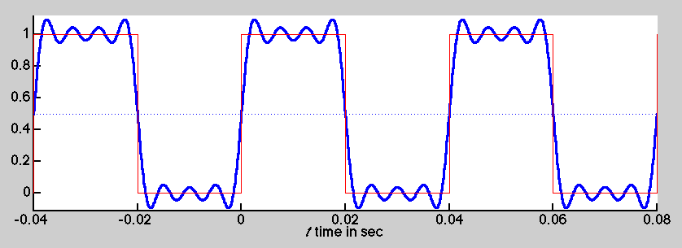
Synthesis: up to 7th Harmonic
© 2003, JH McClellan & RW Schafer

Slide 12
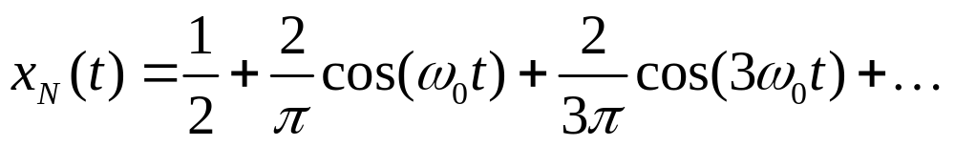
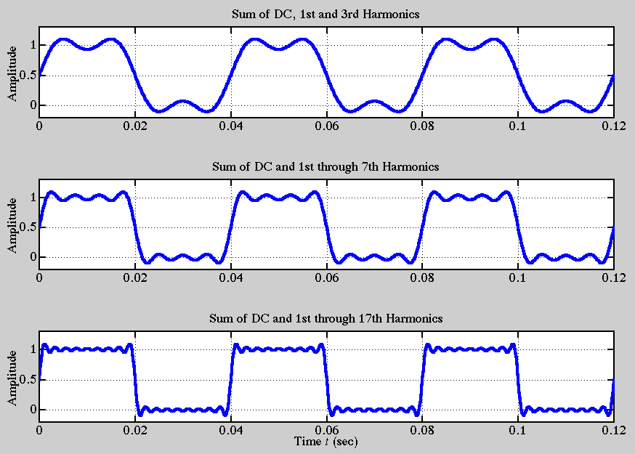
Fourier Synthesis
© 2003, JH McClellan & RW Schafer

Slide 13
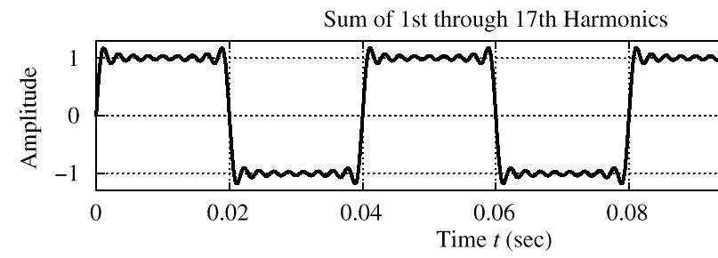
Gibbs’ Phenomenon
Convergence at DISCONTINUITY of x(t)
  There is always an overshoot
  9% for the Square Wave case
© 2003, JH McClellan & RW Schafer

Slide 14
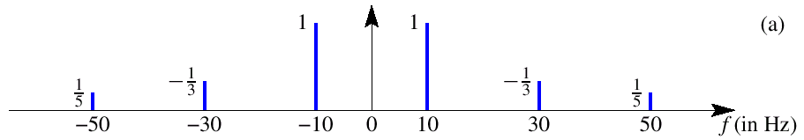
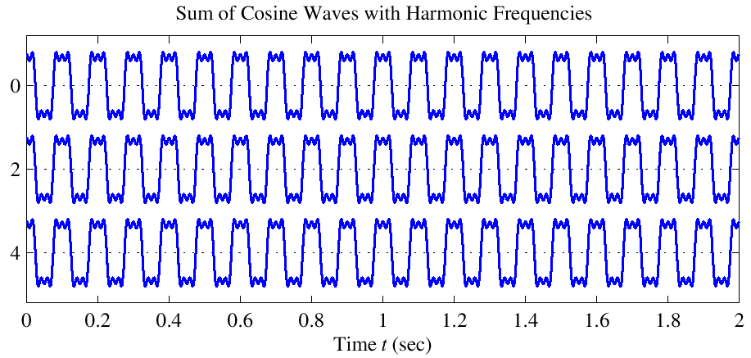
Harmonic Signal (3 Freqs)
a₁
a₃
a₅
T = 0.1
© 2003, JH McClellan & RW Schafer

